Slide 1
Towards a Trusted Execution Environment via Reconfigurable FPGA

Slide 2
Contents
Problems
Threat Model and Requirements
Design
Proof of concept
Evaluation

Slide 3
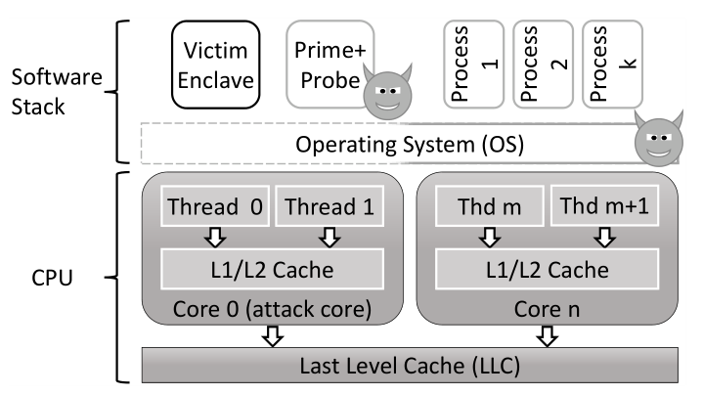
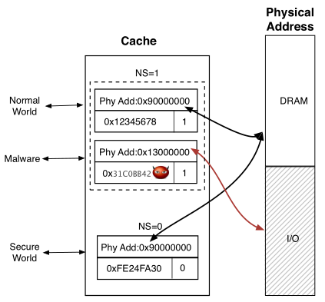
Problems
“TrustZone and SGX have been successfully attacked multiple times”
Software grand exposure: SGX cache attacks are practical
CacheKit: Evading memory introspection using cache incoherence

Slide 4
Problems
PL act as a TEE……？
physically isolated √
control mechanisms are hard to attack √

Slide 5
Threat Model
attacker can take control of the REE and the interfaces to the TEE components
attacker may try to reconfigure the FPGA hardware
bitstream installed in the FPGA is authentic and cannot be replaced
TEEOD TAs can be malicious
steal security-sensitive data from other TAs
attack the host platform by attacking secure devices or accessing
protected memory regions
D. Cerdeira, N. Santos, P. Fonseca, and S. Pinto, “Sok: Understanding the prevailing security vulnerabilities in trustzone-assisted tee systems,” in 2020 IEEE Symposium on Security and Privacy (SP), pp. 1416–1432,
2020.

Slide 6
Requirements
Isolation from the REE
Isolation from other TAs
Application management control
Identification and binding
Trusted storage
Trusted access to peripherals
State of the art cryptography
Global Platform, “Introduction to Trusted Execution Environments,” 2018. Accessed: June 2021.

Slide 7
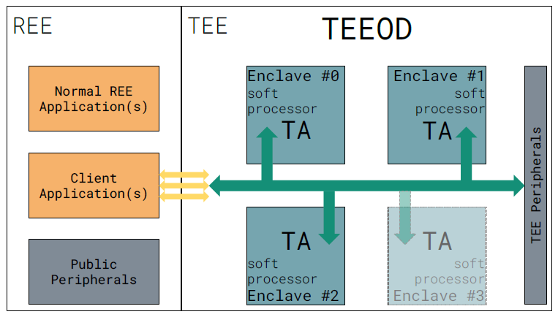
Design
Design Principles
avoid sharing hardware and software resources
principle of least privilege
well-defined and carefully designed interfaces
Design Overview

Slide 8
Design——Enclave Life-cycle
Enclave Creation
list of the available enclaves, loaded TAs
CA call the TEE Client API to connect with the TEEOD
(if TA is not loaded) TEEOD copies the target TA binary to a private memory
TA enters in wait for interrupt state
Enclave Execution
REE sends information to TEEOD
TEEOD interrupts TA
TA reads the message and perform the command
TA notifies the TEEOD that operation finished and goes back to WFI state

Slide 9
Design——Enclave Life-cycle
Enclave Destruction
REE calls the close session function
TEEOD notifies the TA that the session shall be closed like any other command
TEEOD clears the memory region of the enclave, hard resets the soft-core
marks the enclave as available, removes the TA’s UUID from the list, ensuring no information is leaked

Slide 10
Design——Communication handling
REE applications can exchange information via raw data or shared memory with TAs by leveraging the TEE Client API
CA needs to pass the TEEOD:
the UUID of the target TA
the requested message in form of shared registers
the message type
the access permissions that the TA has to the message
TEEOD validates the received information, sends the message to
the desired TA through shared registers in case of success
Replies go backwards

Slide 11
Design——Shared Memory Management
used to transfer large blocks of data
REE CA first allocates the requested memory, provides the address and size of the shared memory area in use
communicates memory pointer and size as normal message

Slide 12
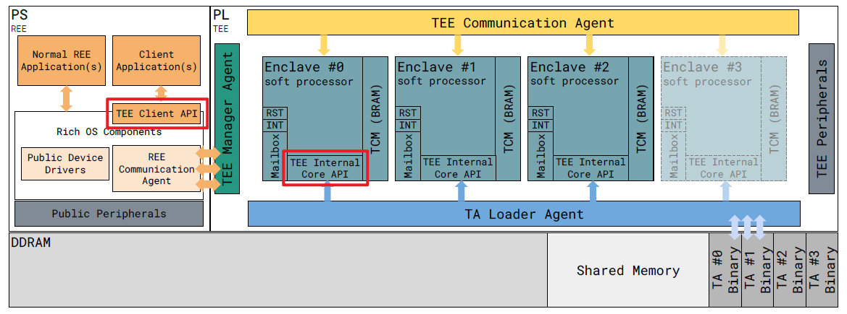
Proof of concept
TEE Hardware Blocks, TEE Client API, TEE Internal Core API

Slide 13
Use case: bitcoin wallet
uses a subset of features of the TEE internal core API
random number generation
secure storage
cryptographic primitives
other cryptographic related operations
functions:
checks if a master key already was generated
generates a new master key and corresponding mnemonic, i.e., seed phrase
generates a new master key from a given mnemonic
deletes a master key
signs a blockchain transaction
obtains the bitcoin wallet address

Slide 15
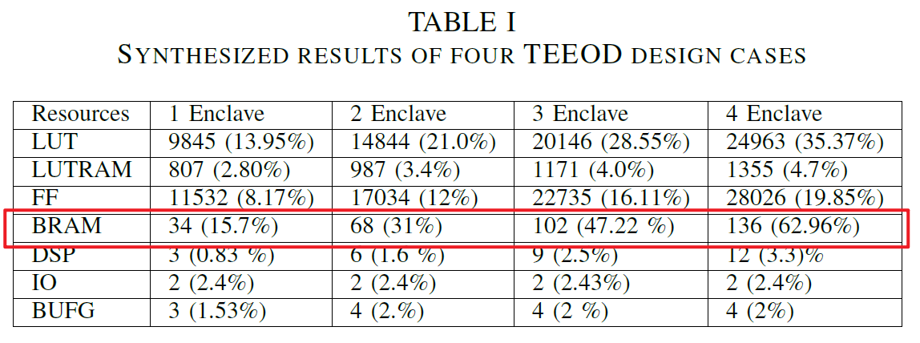
Evaluation

Slide 16
Evaluation
Operation | Time
open session | 54.4 ms
open session of existing TA | 31.1 us
returns a value incremented by one | 201.0 us
outputs a 16-byte array to shared memory | 327.05 us
close session | 40.1 us

